Slide 1

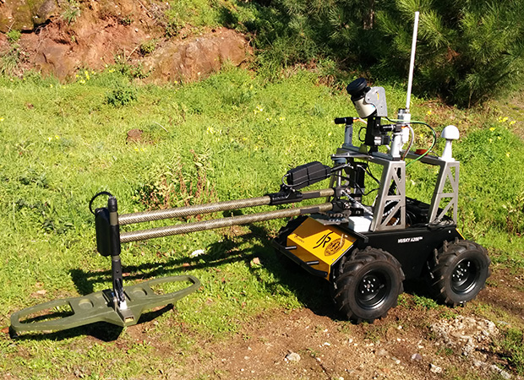
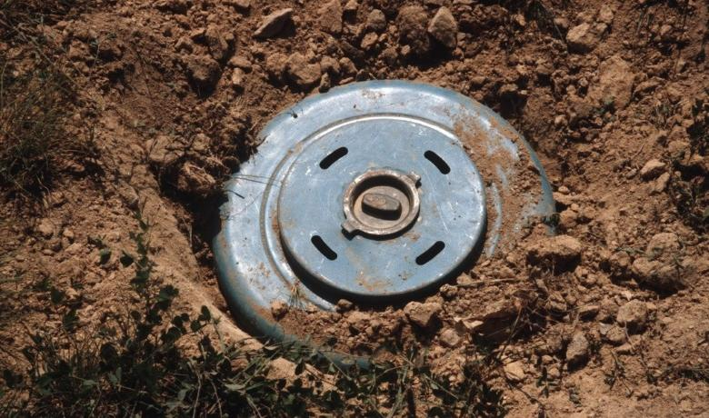
Landmine Detection Robot
· In many war-torn countries in the world, various unexploded ammunition and landmines are scattered all over the place.
· To improve demining performance and enhance the safety of deminers, we plan to design an efficient and humanitarian mine action device, which will be more accurate and reliable detection of mines in an area and also will be critical to clearance and successful demining.
· Landmine Detection robots can uses Arduino uno Rev3 (microprocessor) to operate sensors such as imu, LDC, camera, etc., and drives the stepper- motor at the same time, so that the robot can move around the area

Slide 2
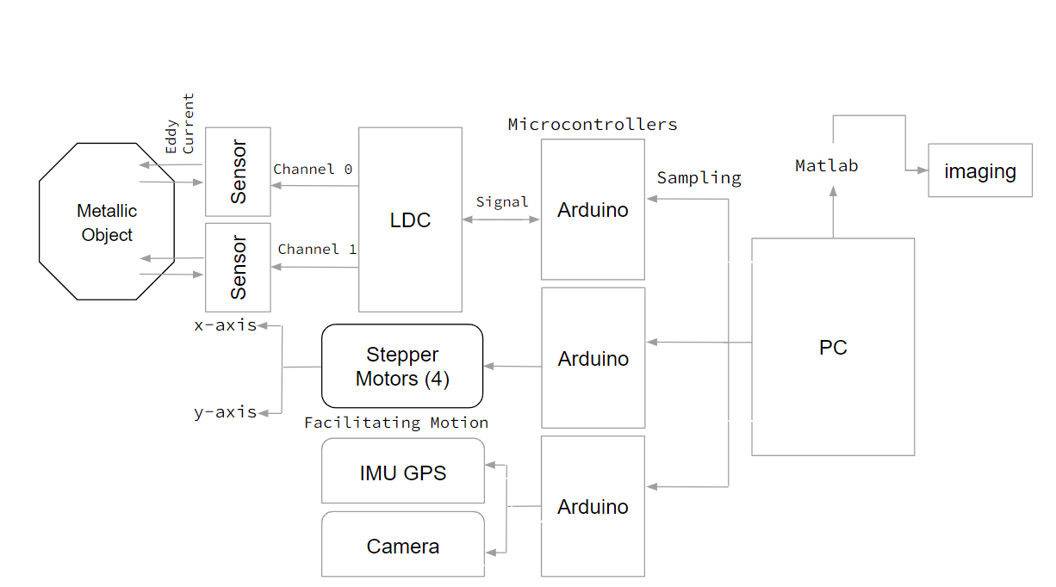
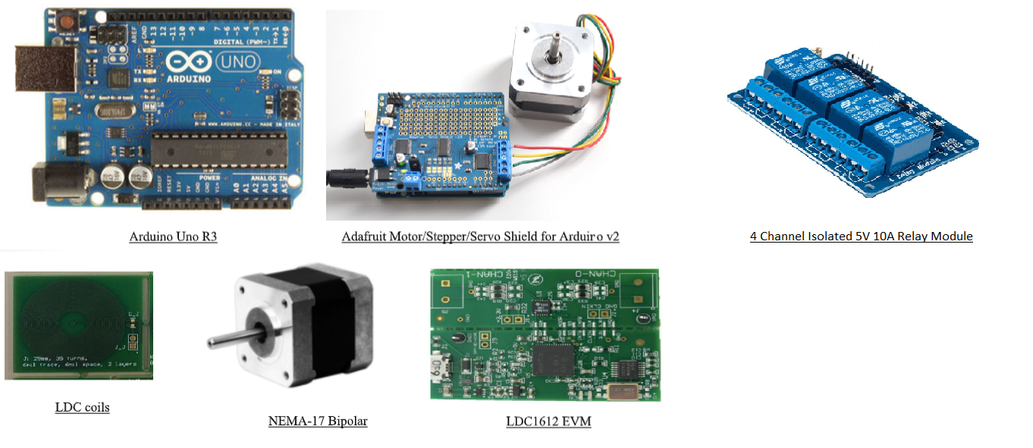
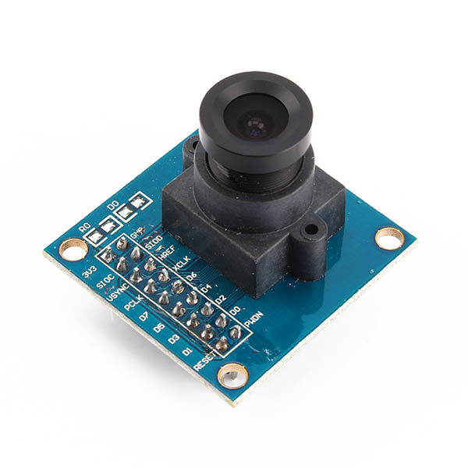
Navigation
· Eddy Currents are loops of electrical current caused by a changing magnetic field in a conductor, in this way we can detect metal landmine underground
· Cameras are used for safety considerations as a collision between the robot and any living thing, and the cameras’ feedback also helps monitor and manage the robot speed and path.
· Filtered IMU with Camera IMU used as measurements for the Kalman filter, with wheel encoders providing odometry predictions. Which is used to localize the base frame in the generated depth map and calculate trajectories to the landmine position.

Slide 3
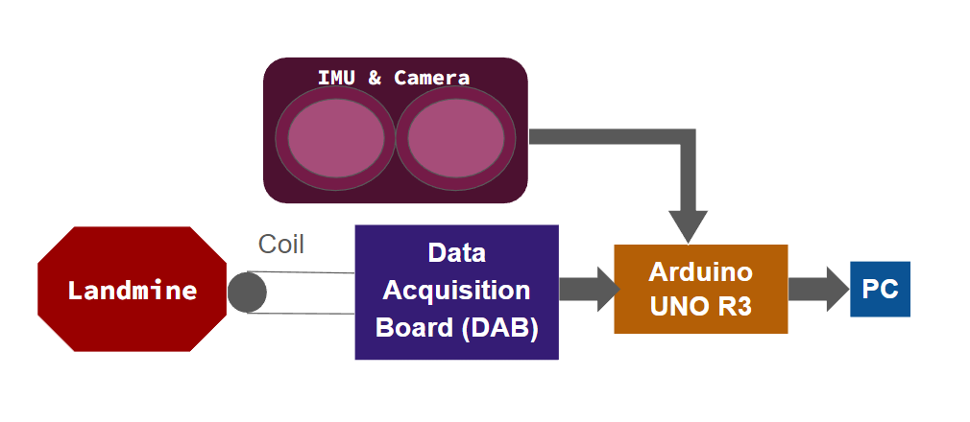
Sensor
· DAB sensor - (Including Eddy current sensor) which is used to detect metal object position
· GPS sensor - which is ussed to identify robot position
· Camera - which is used to read signs, signal and avoid collision with living objects
· IMU - which is used to measure robot acceleration and heading

Slide 4
Power & Budget
· Cost and power Consumption Analysis
Component | Unit Price | Operating Current/Voltage | Average Power(mW)
Arduino UNO R3s(×3） | $18 | 20mA / 7-12V | 200
Stepper Motor（×4） | $22 | 5000-7500mA / 24V | 120000
Data Acquisition Board | $99 | 100mA / 10V | 10000
RGB Camera | $35 | 100mA / 5V | 500
VN-100s(IMU） | $450 | 40mA / 5V | 200
Jetson Nano | $100 | 2000-4000mA / 5V | 21500
Copper Foil Tape (30cmx20cmx0.025mm) | 5pc for $12
Total | $730 |  | 152400
Component | Max Discharge Current / Voltage | Run Time
Gel Type Lead Acid | 289.2 A / 36V | 1.6 Hours with Max rate speed and max rated incline
· Battery Runtime duration

